Slide 1
Federated Analytics for the Enterprise February 2018
Mythili Venkatakrishnan
IBM Distinguished Engineer, IBM Z, Analytics Technology & Architecture Lead
mythili@us.ibm.com

Slide 2
Agenda
Analytics Industry Trends
Focus for IBM Z: Analytics & Cognitive
Federation, Integration, Enablement, Modern Interfaces
Key Use Cases
IBM Open Data Analytics for z/OS: Foundation for Enterprise Analytics & Machine Learning
Enhanced Value with IBM z14
Complementary Function with DB2 Analytics Accelerator
Getting Started

Slide 3
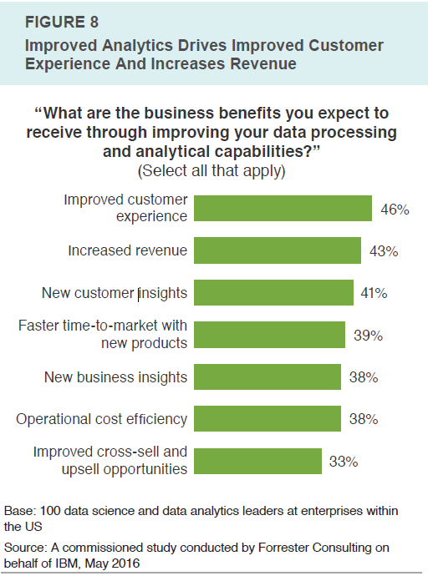
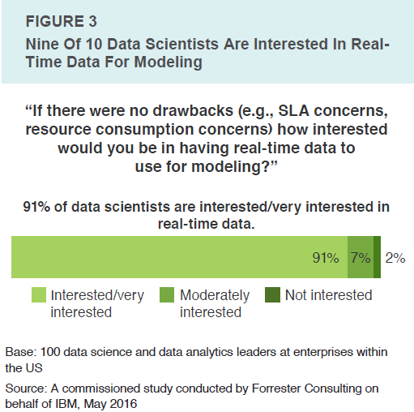
Trends in the industry
Pervasiveness of Analytics
Business growth
Risk Mitigation
Need for Real-Time
Insight at point of impact
Source & Full Forrester paper: https://www-03.ibm.com/systems/z/solutions/real-time-analytics/data-analysis.html

Slide 4
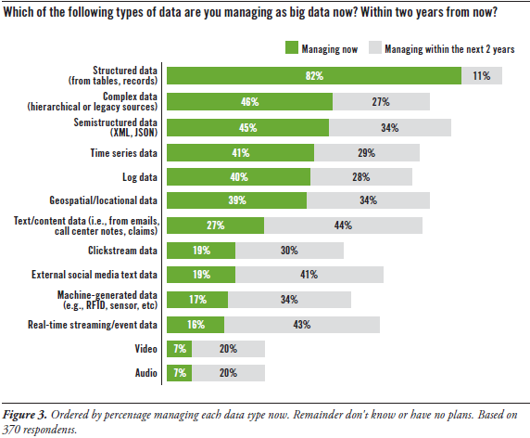
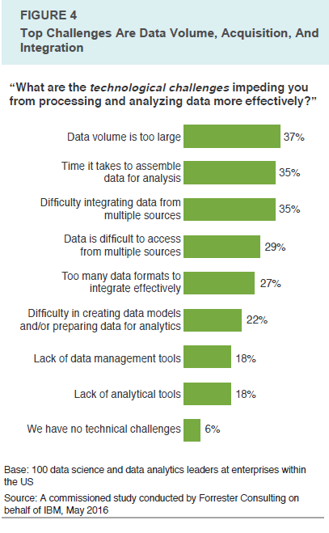
Structured, transactional data drives analytic outcome, but challenges exist
Challenges:
Data integration
Disparate sources
Volume of Data
Model creation and preparation
Source: TDWI Best Practices Report, Dec 2016, Data Science and Big Data, by Fern Harper
Source: A commissioned study conducted by Forrester Consulting on behalf of IBM, May 2016
Notes:
BA Cognos 10 Template
2/26/2018
Presenter name here.ppt
4

Slide 5
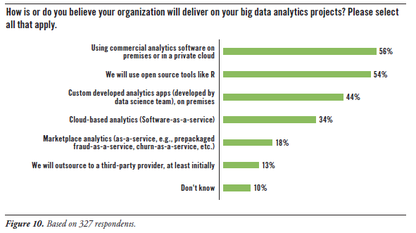
How is Enterprise Analytics Likely to be Deployed?
On premise, leverage commercial analytics tools
Leverage open source
Custom applications, on premise
Source: TDWI Best Practices Report, Dec 2016, Data Science and Big Data, by Fern Harper
Notes:
BA Cognos 10 Template
2/26/2018
Presenter name here.ppt
5

Slide 6
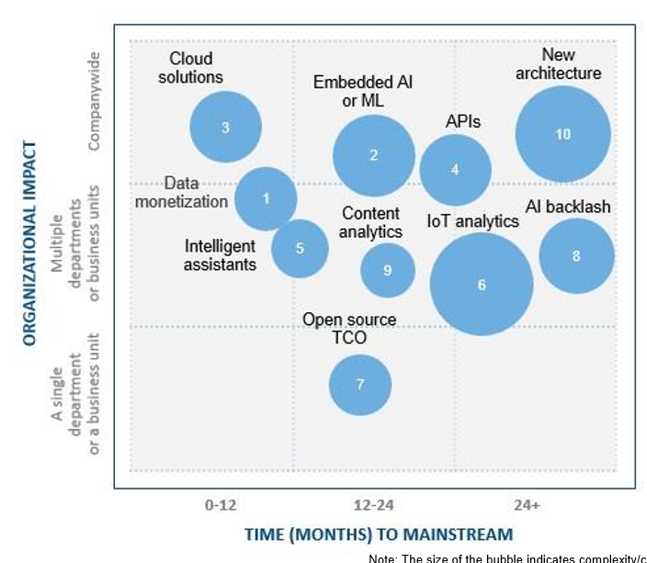
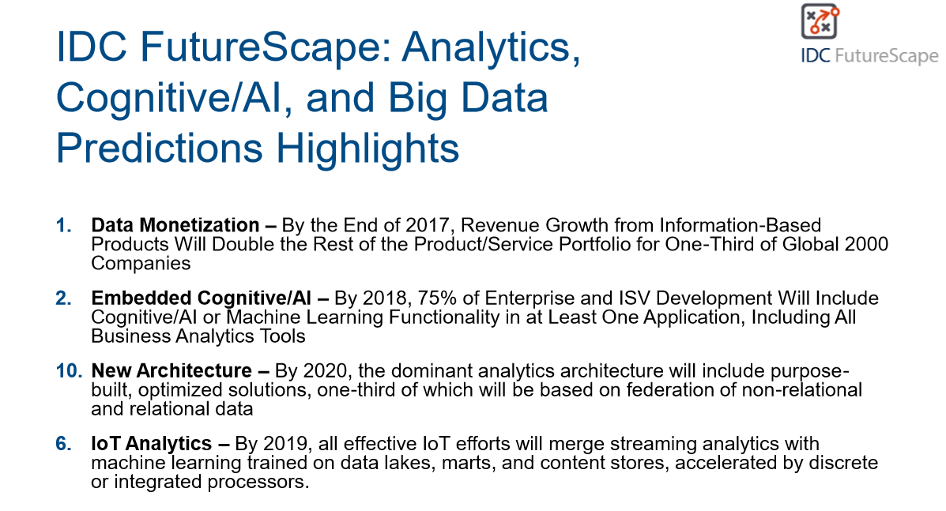
Market View mapped to IBM Z Analytics Strategy
IDC forecasts ww revenue from analytics to exceed $150.8B, 12.4 increase over 2016
Projected 11.9% CAGR through 2020
Largest growth of analytics spend is in banking, insurance, securities & investment services
IDC identified top use cases for FSS: fraud, risk, enhance / optimize customer journey
Government & Professional Services also strong
Data monetization, embedded analytics have high impact, shorter time to mainstream & small / med. Cost impact
Sources: IDC FutureScape: Worldwide Analytics, Cognitive/AI, and Big Data 2017 Prediction
https://www.idc.com/getdoc.jsp?containerId=prUS42371417

Slide 7
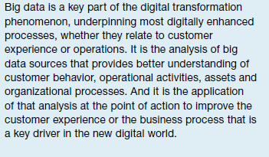
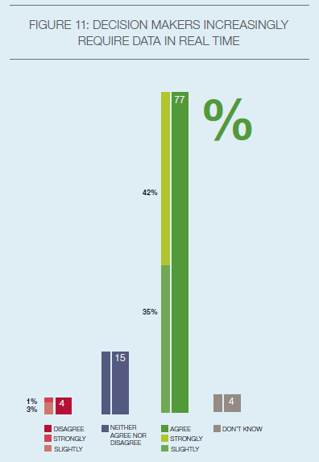
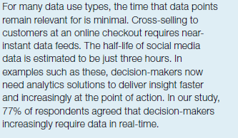
Capgemini Big & Fast Data: The Rise of Insight-Driven Business, March 10, 2015

Slide 8
Focus for IBM Z: Enabling Federated, Agile Analytics

Slide 9





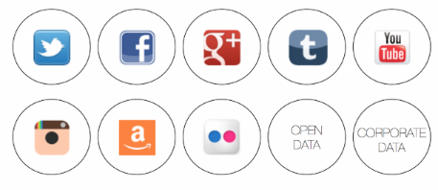
Today’s Typical Current State: migrate all endpoint data to a data ‘lake’, then analyze
Call
Center
Distributed
Warehouses
ODS
Client Facing Apps
Departmental Datamarts
z/OS
DB2, IMS, VSAM
Transactional Data from Operational Systems
History Data
Warehouses
Data / Analytic Currency
Increased security, governance, privacy risk
Longer ROI for analytic insights
Added development costs
Data coherency of the lake
Ability to quickly adapt to suit analytical needs (new data sources, schemas, freshness, etc.)
?
Challenges
Chat
Mobile
Social / Public
Data Scientist
Using an ETL-only approach results in costly side-effects: risk, reduced efficiency and missed opportunity

Slide 10
Key Themes
Meet clients where they are today:
Integration with existing data warehouses & reporting tools is critical
Understand analytic needs within the organization and define entry points accordingly
Focus on providing additional value, not replacement
Federation of analytics across wide variety of data, incorporating more real time views
Target select reduction in ETL for cost savings, not removal of all ETL
Modernization focused on open source & differentiated IBM Z capabilities
Base infrastructure for modernizing interfaces & core analytic capabilities is key
Multiple & tailored entry points possible depending on desired outcome

Slide 11
Use Cases Well-Aligned with Analytics on IBM Z: Data Gravity
When predominance of data originates on IBM Z, z/OS (transactions, member info, policy info, history, claims….)
When data volume is large and distilling data at origination points provides operational efficiencies
When real-time / near real-time insights are valuable and core systems of record are on IBM Z
When security / data privacy needs to be preserved during analytic operations
When performance matters for highly efficient access to variety of data on and off IBM Z

Slide 12
Key Use Cases – Focus Areas
2 Modernization
Banking, Insurance, Retail & Distribution, Analytic Value Add Services

Slide 13
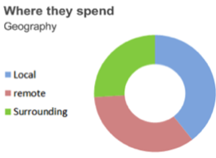
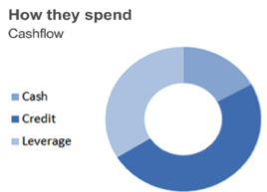
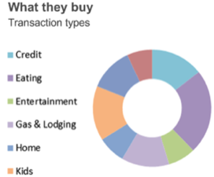
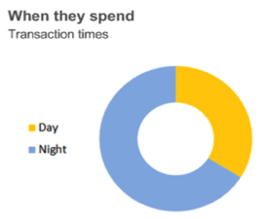



Use Case: Modernization & Data Exploration with Optimized Integration for Business & Data Science Users
Dashboards, Spreadsheets, etc
Easily blend data from Z and non-Z environments without moving vast amounts of data
Enrich reporting and ad-hoc queries
Leverage modern, open technologies & skill base
Result Store:
Frequently refreshed result sets
Integration with business users
Good TCO advantage
Access
JDBC
ODBC
REST
noSQL
Examples: Cognos, Tableau
IBM Open Data Analytics for z/OS
Existing Data Lakes
Optimized Data Layer
z/OS
DB2 z/OS
Model204
IMS
Hadoop
Warehouses
Benefits:
More current data leveraged
‘Pull’ model from consumers reduces raw data movement costs
Integrated across multiple environments
Security & Privacy Advantages

Slide 14
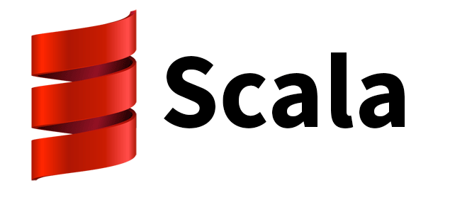



Use Case: Distillation - Federated Analytics for Extending / Optimizing Existing Data Lakes
Consistent, Modern, Industry Prevalent Analytic Interfaces & Languages:
z/OS Environment
Distributed Environments
Typical Business Apps:
Core banking, claims adjudication, tax processing, credit card processing
Based on CICS, IMS
Supported by DB2, VSAM, IMS, PS, …
Distill, blend, transform, reduce & move relevant insights
Typical Business Apps:
Call center, client facing, etc.
Often based on MS, Oracle apps
Supported by Oracle, DB2 LUW, HDFS, etc.
Open Analytic Runtimes: Apache Spark, etc.
Open Analytic Runtimes: Apache Spark, etc.
Optimized Data Layer
Benefits:
Insight from most current business data
Increase efficiency through reducing ETL
Deployment flexibility via “Data gravity”
Attain real-time insights where needed
Leverage common analytics skill
Text Logs
Oracle
HDFS
Trans
Cust
Pmts
External

Slide 15
Use Case - Banking: Enhanced Card Fraud Detection
IBM z/OS
Point of sale systems
Existing Rules Engine
Apply in-house rules for detect
Invoke 3rd party scores (FICO)
Apply custom scoring
Determine Disposition
Core Card Process
Verify, augment data
Manage workload
Ensure scale
Likely: CICS, IMS
ETL
Warehouse
Warehouse
Coding
IBM z/OS
DB2
IMS
VSAM
Create Models
Apply Data Science
Refresh Models
Schedule Deployment
DB2
IMS
VSAM
Deploy
Real Time Analytics: leverage in-place current access to variety of data sources
Today: Models refreshed periodically, deployment path requires custom coding
Challenge: Emerging fraud pattern detection delayed, model deployment & refresh not agile
Benefit: Current data for modeling, intra-day model refresh, flexibility to add new data via configuration

Slide 16
Use Case - Banking: ACH Analytics
Real-Time Insights
IBM z/OS
Real-Time Analytics
Real-time payment and ACH analytics on RT payments
Increased granularity of compliance / risk / fraud analytics
Integration across ACH and core banking systems
ACH Processing:
ACH Payment origination & receipt
Interaction with Automated Clearing House verification
Implementation of NACHA rules
Defined data formats for exchange of info
Batch Posting Process
Future: Real Time Process
“All Items”: ACH, POS, WEB, etc
ACH format
ACH format
ACH format
Today: Largely post processed, multi-day verification of ACH rejects, fraud / risk assessment
Challenge: Same-day payments creates requirement to address rejects, fraud immediately, in real-time scope
Benefit: In-place, real-time analytics of ACH data for compliance / fraud risk to address same-day payments

Slide 17
Use Case – Health Insurance: Proactive Claims Analytics
Claims Adjudication
Claims Disposition
Proper Claims
Integrated real-time assessment to tag claims with insights
Likelihood of overpay > 90%
Likelihood of call > 80%
Benefits mismatch
Deliver Benefit
Assess Overpay
Claims Books of Record
Member
Data
Fraudulent Claims
Claims Process Flow
Provider Data
Deny
? Member Appeal
Unmet eligibility
Pricer Data
Today: Largely transactional batch systems leveraging edits & static rules for determining claim viability
Challenge: Results in overpayment recovery expenses & potential member friction
Benefit: Real-time analytics to prevent improper payments before they leave, and to identify other efficiencies

Slide 18

Supplier processes request
Goods shipped
Arrival at Distribution Centers
Arrive at Local Distribution Center
Goods delivered
Dynamic Adjustment and Optimization of Resources
A
B
C
A
B
C
A
B
C
A
B
C
A
B
C
OLTP environment
Deployed Predictive Models
Inventory
History
Stores
Suppliers
Business Advantage: dynamically estimate and adjust resources (products, labor, trucks, etc.) as goods progresses through the business process, even intra-day
Example: leverage data including history of volumes on given day, month, period, history of goods distributed from various centers, patterns based on weather, other events impacting resource loads to proactively predict resource and product requirements, deliver best match of availability of products to goods …
The predictive insight can feed existing resource planning and adjustment engines
Key Factors ….
Very efficient scale for advanced predictive insights, with analytics as part of transaction flow
Enables SLAs to be kept while introducing advanced analytics ‘in-process’

Slide 19
Analytic Services -- Monetize Key Data for Value Added Services
OLTP
Client
Client
Real-Time Analytics & Recommendation Service
External Data: economic, market, geopolitical
Analysis of External Data
Client
Customer Info
History
Loan Servicing History
Assets
Recommendations Service tailored to client, using analytics of client, history, products, profiles, likely client life change event (marriage, new child, college), risk….
Insight from external data, triggering real-time analytics on transactional / systems data
Integrate information across multiple product lines, transactions and history in order to make the best real-time, targeted decisions
Example: immediate, real-time analysis of multiple data sources, determine best action for increasing top line growth & client retention
Leverage hybrid structure for best-fitting analytics with originating source of data -- gain efficiency of operation & insight at point of impact

Slide 20
IBM Open Data Analytics for z/OS: Foundation for Enterprise Analytics & Machine Learning

Slide 21
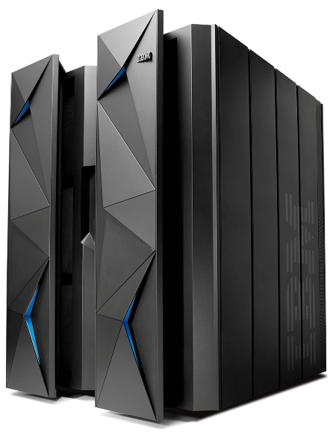



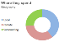
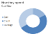

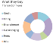




Leveraging IBM Z for Optimized Analytics
IBM Machine Learning for z/OS
Govern, Manage, Algorithm Assist…
Business Applications
Data
ML Algo
Data Prep
Model
Deploy
Predict
Analytic Result Sets
Monitor, Feedback
Distilled Insight
Distilled Insight
Query Acceleration
IBM Open Data Analytics for z/OS
Python
Optimized Data Integration Layer
Merchant
Transaction
Customer
Distributed Apache Spark
Pauselss GC
New SIMD instructions
Pervasive Encryption
32 TB Memory
Federate analytics leveraging data in place for more current insights at scale,
optimized security, privacy and reduced costs
21
Notes:
BA Cognos 10 Template
2/26/2018
Presenter name here.ppt
21

Slide 22
Applying Data-in-Place Analytics within the Enterprise: IBM Open Data Analytics for z/OS
IBM Machine Learning for z/OS
Solutions from SIs & Business Partners
Other IBM based solutions & Client Solutions
Leverage most current data, in place
Flexible structure, rich analytics runtime co-located with IBM Z data
TCO advantages
Leverage leading open source technologies & skills
Enable advanced solutions from IBM and partners
Integrate and differentiate
Solutions
Apache Spark for z/OS
Python / Anaconda Open Source stack
Optimized Analytics Runtime
Optimized Data Layer
z/OS
Enterprise Data Environments
z/OS
Distributed
Core Banking
Client Data
Loan Data
HDFS
Warehouse

Slide 23


IBM Open Data Analytics for z/OS: Three Major Components, Integrated Analytics Runtime
Python 3.6.1 support
Anaconda: core analytic libraries
Enables access to the z/OS channel on the Anaconda Cloud for future package installs
Python use in Jupyter Notebooks
Python use from Apache Spark z/OS
Integration with workload management and security
IBM Open Data Analytics for z/OS
Apache Spark for z/OS
Python / Anaconda Stack
In-memory analytics framework and runtime
Supports applications in Java, Scala, Python
Enables various styles of analytics: SparkSQL, Streaming, Machine Learning libraries, and Graph style processing
Original availability March 2016
Version 2.1.1 of Apache Spark
Workload Management and end to end security Integration
Optimized Data Layer
User Interface
z/OS
Integrated , efficient access to data in place for wide variety of data on z/OS and off platform
Integrated Access to DB2, IMS, IMS raw read , VSAM, PS, PDSE, ADABAS, IDMS, CICS Queues, Virtual Tape, SMF, Syslog, Oracle Enterprise, Teradata, HDFS… etc.
Performance enhancements for memory-to-memory access of Spark / Python
Integration with IBM Application Discovery and Delivery Intelligence
Integration with business applications via persisted result store on z/OS
Autogen of optimized data access Scala code
Data Privacy Features

Slide 24
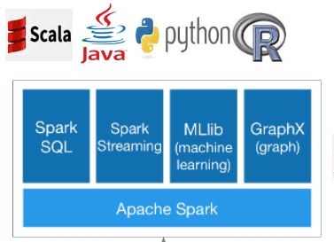
Apache Spark z/OS
An open source big data processing framework built around speed, ease of use, and sophisticated analytics, originally developed in 2009 in UC Berkeley's AMPLab, and open sourced in 2010 as an Apache Foundation open source project.
Speed
An in-memory compute engine that works with data; not a data store
Ease of Use
Write applications quickly in a variety of languages (Java, Scala, Python, R).
Generality
Combine SQL, streaming, and complex analytics.
Runs Everywhere
Enables highly iterative analysis on large volumes of data at scale.
Runs on Hadoop, Mesos, standalone, or in the cloud.
http://spark.apache.org

Slide 25
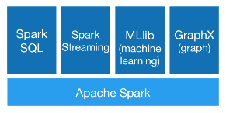
Apache Spark z/OS: Data in place, federated analytics
Federated analytics across multiple sources of data
Data: structured or unstructured, any data environment supported by Spark z/OS:
IBM Z:
DB2, IMS, VSAM
Adabas
Syslog
PDSE
Etc
Distributed:
Oracle
Filesystems
Hadoop
Etc
DF
DF
Optimized data Layer
Spark Transform actions across multiple data environments: apply a map function to each, filter, sample, union, intersect, joins…
Apply Spark Actions, for example Analytic Algorithms found in MLIB: clustering, PCA, logistic regression, classification, random forest…
Results of analysis

Slide 26
Popularity of Python for Data Science
Growing traction for Python language as basis for data science
Large and increasing community –both business and educational institutions
Simplicity of use for new data scientists
Availability of skills through universities using Python for coursework
Can be used in Apache Spark environment or standalone
Distributions and Package / Environment management tools support

Slide 27



Anaconda
Package library
(Python & other) 700+ packages
Environment Management
Package Management
Flexibility: Library includes packages from any language, including Python, Scala and R
Ease of use: Libraries include popular data science & machine learning functions (scikit-learn, NumPy, pandas, SciPy,…
Simplified Management: A fundamental piece of infrastructure allowing data scientists to navigate and manage hundreds of packages across platforms and versions
Collaboration: Once assembled into environments, package configurations can be shared and managed as single units

Slide 28

Key Python & Anaconda Values for z/OS clients
A trusted repository – part of the Anaconda platform
https://docs.continuum.io/anaconda/pkg-docs.html
Agility: Alleviates SMP/E requirements for individual package management
Security: Allows customers to establish their own repository behind their firewall
Trusted Source: Internal repository mirrors to 1 trusted source on Anaconda ‘z’ channel
Time to implementation: Packages made available outside product service stream, ecosystem engagement
Customer’s Anaconda Private Repository
Anaconda Package & Environment Management
Firewall
Pandas
. . .
. . .
Package
Repository on z channel
Dask
. . .
. . .
z/OS
NumPy
. . .
. . .
SciPy
. . .
. . .
scikit-learn
. . .
. . .
. . .
. . .
. . .
. . .
. . .
. . .
. . .
. . .
. . .
Anaconda enables flexible package distribution

Slide 29
Key Benefits to co-locating Analytics with Enterprise Data
Unique Value | How?
Currency of Insight | Access the most current data for insights at point of impact
Abstraction | Abstract applications from specifics of data type & structure; leverage modern open source technologies
Richer Analytics | More advanced SQL standards than vanilla open source (SQL92 and SQL99)
Integration | Easily persist results, share via dashboards and other existing business user toolsets in hybrid environment
Security & Privacy | Leverage source data’s original security specification; Configure for data privacy
Performance | Co-location with data sources; optimized, parallel load of data resulting in faster end-to-end analytic performance; Java on zOS performance features
TCO | Optimal zIIP use for Spark &Optimized Data Layer; Container pricing support for Python & Anaconda
Cost Reduction | Benefit through selected reduction of ETL and associated costs for analytics
Federation | Consistent access to wide variety of data environments on and off the platform (DB2, VSAM, IMS, PS, PDSE, SMF, SYSLOG, ADABAS, IDMS, Oracle Enterprise, Teradata, HDFS…)
Ease of data access | Automatically generate optimized code to access various data environments
Flexibility for new Data | Quickly add in new data sources through configuration, not coding
Simplified data formats | Pre-defined mappings for common data formats such as SMF, ACH, ISO 8583-1
Analytic Insights Advantage
Analytic Infrastructure Advantage
Simplification Advantage

Slide 30
Key Benefits: Leveraging IBM Z HW and Operating System Capabilities
Unique Value | How?
Scale up, Large Memory | Leverage scale-up environments and larger in-memory frameworks for optimal analytic performance
Java Optimizations | Leverage of SMT, zEDC, large pages transparently via Java runtime for z/OS
SIMD Operations | Value for analytic and cognitive algorithms leveraging SIMD through Java stack
High Availability | Leverage z/OS capabilities for data sharing & IBM Parallel Sysplex support for analytic functions and to ensure data availability to feed analytics
Large Databases | Leverage z/OS 2.3 to support larger data environments & data volume growth
WLM Exploitation | System Administrator can classify different Spark z/OS analytic workloads with different priorities to ensure system resources are used in line with business goals
SAF Integration | Integrated end user authentication allows a Spark user to be validated by a z/OS security manager, such as RACF – enhances security of the environment as well as simplifies auditing.
z14: Pervasive Encryption | Leverage comprehensive data encryption and data-in-place analytics to protect valuable data and insights
z14: Pause Less Garbage Collection | Scale up to large Java heap sizes for optimal performance and avoid unnecessary delays during garbage collection
z14: 32 TB memory | Provide optimal environment for in-memory compute frameworks like Apache Spark
z14: SIMD Operations | Increase performance when using complex cognitive / machine learning algorithms

Slide 31
Advantages of In-Place Analytics on z/OS:
Data Co-location & Federation of Analytics for Real-Time
Wide Variety of Data Accessible
Modern Analytic Interfaces
Enhanced Data Privacy Options
End-to-end Security
Integrated Workload Management
Simplification via Integration w/ Asset Discovery Tools
Automated Generation of Code
Pre-defined Industry Data Mappings
1
2
3
4
5
6
7

Slide 32
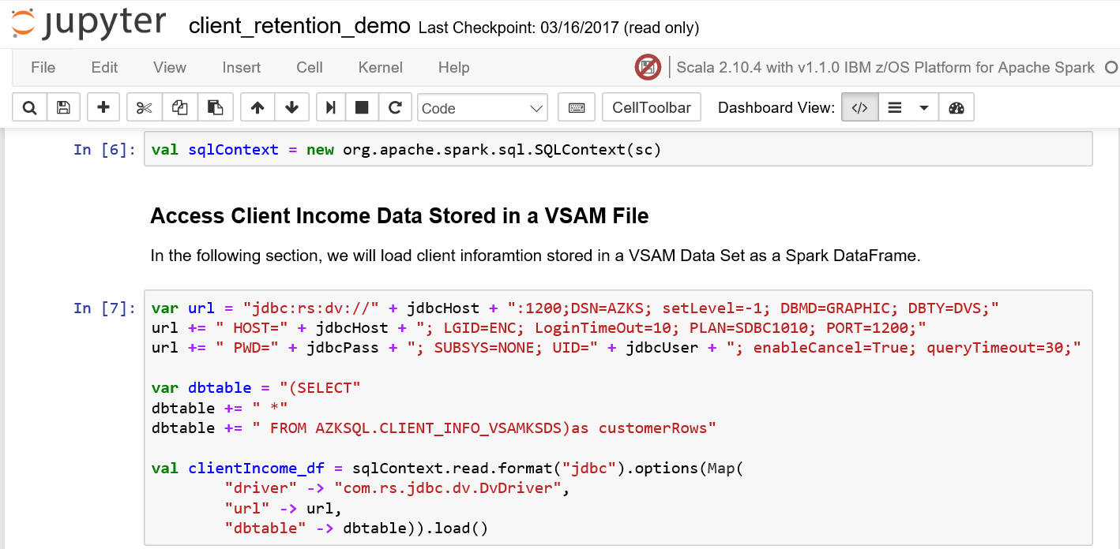
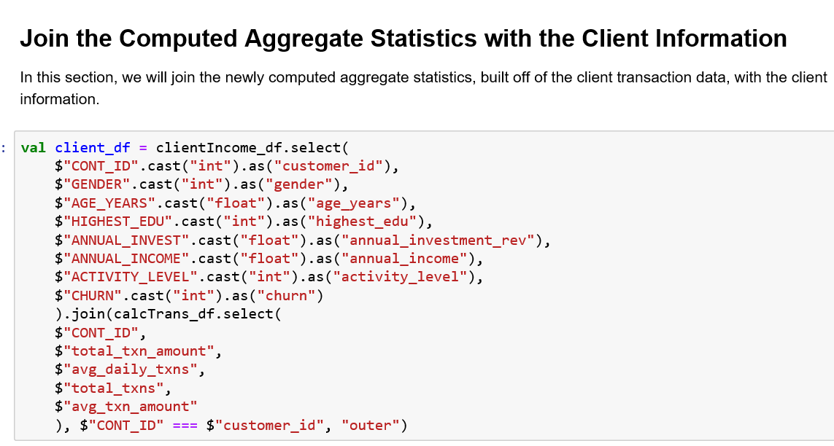
Abstracted access to z/OS Data
} from VSAM
1
Modern Analytic Frameworks & Tools
} from DB2

Slide 33
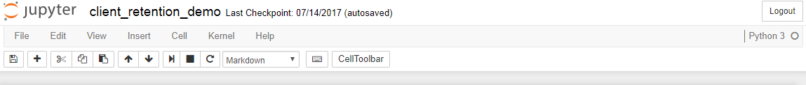
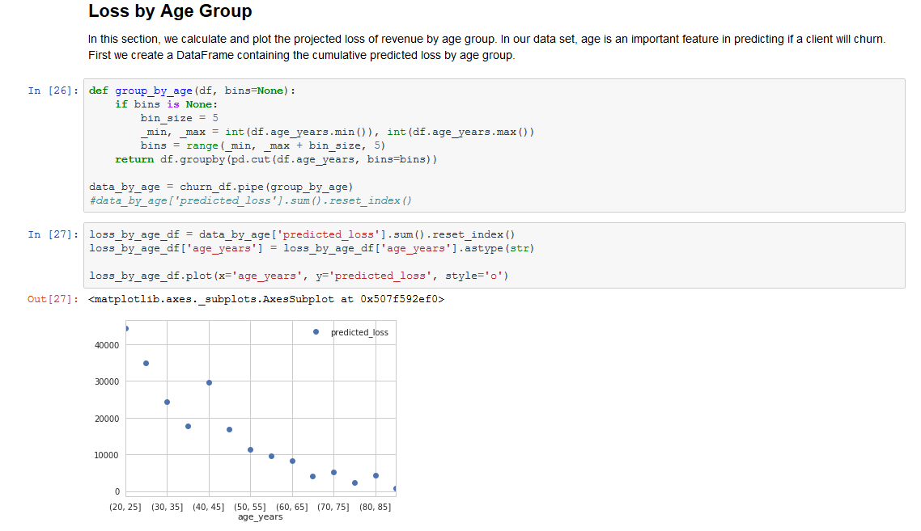
Extending the Ecosystem with Python & Anaconda
Example of Jupyter Notebook interaction with Python / Anaconda Stack on z/OS

Slide 34

2
Value: Reduce Risk → via Simplified Data Privacy via Configuration
Original Table
Cust_ID | Avg Daily TX | Education | Education Group | Social Security Number | Investment | Avg TX AMT | Churn Label | Age
1009530860 | 3.9145 | 2 | BS | 123-84-9015 | 114368 | 2090.32 | N | 84
1009544000 | 4.28 | 2 | BS | 122-49-3821 | 90298 | 2095.04 | N | 44
1009534260 | 1.23 | 2 | BS | 931-29-0612 | 94881 | 1723.59 | Y | 23
1009574010 | 0.95 | 2 | BS | 491-19-2102 | 112099 | 1297.41 | Y | 24
1009578620 | 2.73 | 5 | DR | 813-90-4183 | 84638 | 1333.18 | N | 67
Sensitive Data
View presented to data science teams can be different than original
Via UI configuration, obfuscate or remove select columns
Configure for varying levels of access based on PII designations
Flexibility for data protection
Not Feature
Features
Not Feature, PII
Features
View of Table Visible to Data Scientists
Cust_ID | Avg Daily TX | Education | Education Group | Investment | Avg TX AMT | Churn Label | Age
1009530860 | 3.9145 | 2 | BS | 114368 | 2090.32 | N | 84
1009544000 | 4.28 | 2 | BS | 90298 | 2095.04 | N | 44
1009534260 | 1.23 | 2 | BS | 94881 | 1723.59 | Y | 23
1009574010 | 0.95 | 2 | BS | 112099 | 1297.41 | Y | 24
1009578620 | 2.73 | 5 | DR | 84638 | 1333.18 | N | 67

Slide 35



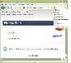

3
Value: Increase End to End Security → with Granular Client Authentication – Spark Example
Jupyter Notebook
Interaction
P
P
Unix Shell Interaction
LDAP
RACF
Linux
z/OS
z/OS
Username
password
Jupyter Hub
Docker Container
Jupyter Kernel
Gateway
Spark Master
Spark-shell
Spark-submit
User’s Docker container
User’s Docker container
Worker
Notebook Server
Notebook Server
Apache Toree
Executor
private network
Optimized Data Layer
DB2
VSAM
IMS
Integrated end user authentication enables a Spark user to be additionally validated by z/OS SAF – end to end, including data access
Enhances security, but greatly simplifies auditing
Authenticate user at each entry point / hop: z/OS TCP/IP Transport Layer Security (TLS) & Application TLS on Linux
Propagation of credentials protected in flight & at rest

Slide 36

Value: Enterprise Resource Management → via Integration with z/OS WLM – Spark Example
4
z/OS
Bob
Jupyter Interface
High Priority
Jill
Unix Shell Interface
Medium Priority
Spark-submit interaction
Spark Master
Jupyter Interaction
Worker
Zach
Jupyter Interface
Low Priority
Executors for Bob
Executors for Zach
Executors for Jill
Service Class= SparkHigh
Service Class= SparkMed
z/OS WLM Service Class Definitions
Service Class= SparkLow
Service Class= SparkMstr
Differentiate Spark Users based on business priority – cpu & memory resource automatically managed based on importance
Manage with response time or throughput goal oriented workload & resource management
Integrate with z/OS system definitions for service classes

Slide 37
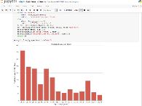

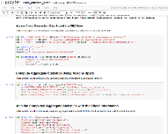
5
Value: Simplification → via Automated Discovery & Configuration of Data assets for Analytics
Multitude of Enterprise Applications & Data
IBM Application Discovery and Delivery Intelligence (IBM ADDI)
IBM Open Data Analytics for z/OS
IBM ADDI
Catalog (Relational Store)
Apache Spark for z/OS
Python / Anaconda z/OS
7
Dataset names
Cobol copybooks
PL/1 include files
A
B
C
Optimized Data Layer
z/OS
Analytic Output
D
Match high level language structures to physical datasets and databases
Validate to associate type of data
Read & analyze as result of SparkSQL or Python Interaction
F
 | z/OS Dataset Name | Type | COBOL Structure
 | CSD.AI38.EMPLOYEE.KSDS | VSAM | EMPLOYEE-RECORD
 | CSD.AI38.DEPARTMENT.KSDS | VSAM | DEPARTMENT-RECORD
 | CSD.AI38.OFFICE.KSDS | VSAM | OFFICE-RECORD
 | CSD.AI38.UPDATE.TRANS | QSAM | NAME-CHANGE-RECORD
 | CSD.AI38.UPDATE.TRANS | QSAM | ADDR-CHANGE-RECORD
 | CSD.AI38.UPDATE.TRANS | QSAM | SALARY-CHANGE-RECORD
 | CSD.AI38.UPDATE.TRANS | QSAM | OFFICE-CHANGE-RECORD
X
Cust_ID | Investment | Avg TX AMT
1009530860 | 114368 | 2090.32
1009574010 | 112099 | 1297.41
1009578620 | 84638 | 1333.18
E
Cust_ID | Investment | Avg TX AMT
1009530860 | 114368 | 2090.32
1009574010 | 112099 | 1297.41
1009578620 | 84638 | 1333.18
X
Map Selected
Cust_ID | Investment | Avg TX AMT
1009530860 | 114368 | 2090.32
1009574010 | 112099 | 1297.41
1009578620 | 84638 | 1333.18
X
Generate virtual tables using simple wizards and batch processes with no additional data collection
X
X
Virtual Tables Consumed by IBM Open Data Analytics for z/OS

Slide 38
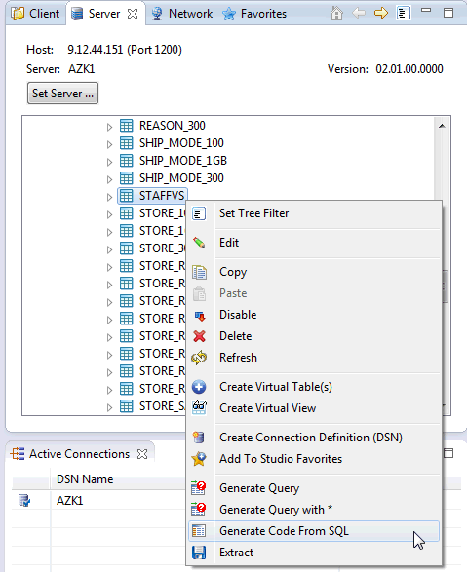
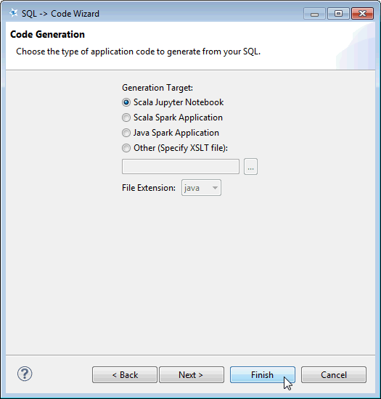
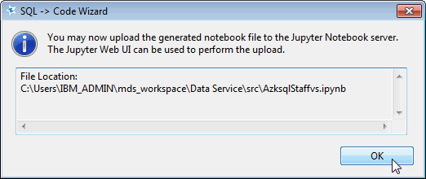
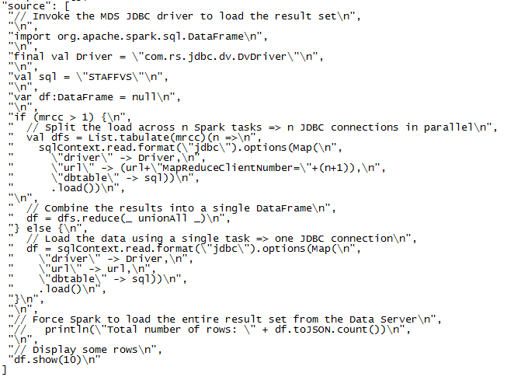
6
Value: Simplification → Automated Generation of Code to Access Data from Spark & Python
Reduce coding of data access via automated generation of Scala code (Python in progress)
Automatically optimized based on available parallelism to generate best performance results without manual coding

Slide 39
IBM Machine Learning for z/OS: Machine Learning in the Enterprise
In our survey of executives at 168 large companies with at least $500 million in annual revenue, 76% of respondents said they are targeting higher sales growth with machine learning, the kind of artificial intelligence software that continuously learns from big data and optimizes recommendations in real time to sales staff. Moreover, more than two out of five companies have already implemented machine learning in sales and marketing.
Before machine learning came along, static databases, analytics from historical data, and experience and instinct steered execution — with performance improvements coming in set increments over time. With machine learning, real-time data can drive actions and process change along a continuous path. Hypotheses can be quickly formed, tested, and revised, enabling a new kind of workflow that can dramatically outperform previous ones.
Source: http://sloanreview.mit.edu/article/sales-gets-a-machine-learning-makeover/ ; MIT Sloan Management Review, May 2016, H. James Wilson, Narendra Mulani, Allan Alter
Notes:
BA Cognos 10 Template
2/26/2018
Presenter name here.ppt
39

Slide 40

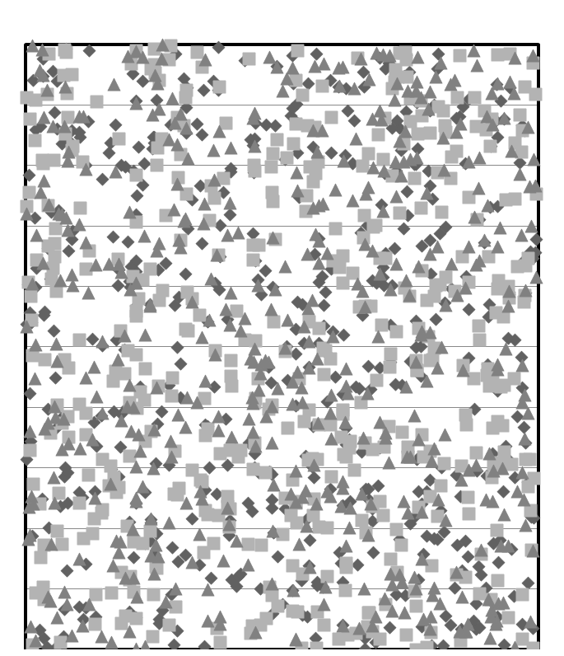
What Can Organizations do with Machine Learning
80% CIOs surveyed state transition from backward looking passive analysis needs to shift to forward looking predictive analytics¹
¹ http://www.gartner.com/imagesrv/cio/pdf/cio_agenda_execsum2015.pdf
Increase customer
retention
Reduce Fraud / Loss with detect & prevent
A Universe of Data
Mitigate risk based on predictions
Drive up-sell and cross-sell
Example:
The purchase history for consumer for last 5 years is with card present at time of sale; current transaction is over $1000, with card not present; but merchant falls into category typical for this consumer’s spend; use predictive analytics to determine likelihood of fraudulent transaction.
Develop insight to questions that are not binary ‘yes’ or ‘no’ → likelihood of a pattern
Predictive Scores provide complementary insight to rules based systems

Slide 41
Example ML Use Cases (including IBM engagements)
Finance
Credit Card Fraud Classification Y/N
Lending Regression ($ approved)
Healthcare
Disease diagnosis Classification: Y/N
Patient Re-admission Risk Classification: Y/N
Manufacturing
Anomaly detection Classification: Y/N, Also “Unsupervised Learning”
Marketing & Sales
Customer Churn Classification: Y/N
Retail / E-tail
Recommendations (“Collaborative Filtering” algorithms)
Transportation & Delivery
Defective goods Classification: Y/N
IT Operations and Maintenance
Anomaly detection Classification: Y/N, Also “Unsupervised Learning”
courtesy: adarshrp@us.ibm.com

Slide 42
Other use cases we see in everyday life
Email Spam Identification Classification Y/N
Hand-writing Recognition Classification (0, 1, ..., 9)
Image Recognition Classification (Pedestrian, Light, Car, ...)
Speech Recognition Classification (and much more)
Natural Language Translation Classification (and much more)
courtesy: adarshrp@us.ibm.com

Slide 43
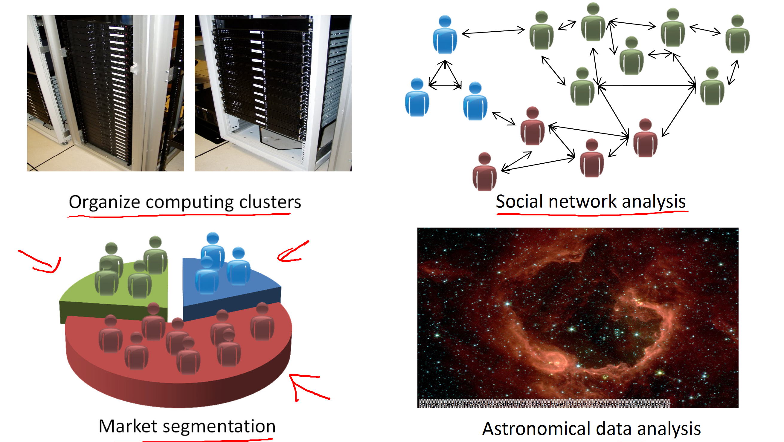
Examples of Unsupervised Learning
courtesy: Andrew Ng

Slide 44
Machine Learning
Supervised
Unsupervised
Regression
Classification
Clustering
Dim Reduction
+++
Linear Regression
Logistic Regression
Support Vector Machines
Decision Trees
Neural Networks
+++
kMeans
+++
PCA
+++
Algorithms
*Simplified Taxonomy
courtesy: adarshrp@us.ibm.com

Slide 45
Insight from Analytics: Many Steps, Iterative, Time Consuming
What needs to be done to the data in order to feed the model?
For example, join claims information with member info, aggregate fields such as claim amounts, classify / bin fields such as age for higher value statistical meaning
Define and execute data preparations
Select model and train with historical data
Break data into training set vs. testing
Evaluate different combinations of algorithm, features & hyper-parameters
Determine best balance of true positive (recall) to false positive (fall-out)
Data
ML Algo
Data Prep
Model
Deploy
Predict
? Monitor ongoing accuracy & identify degradation, Iterate
What data is needed? Example, need claims information, perhaps code look up tables, historical tables, member info, etc.
Attain access to tables & data (multiple data formats…DB2, VSAM…)
Add in new data sources as needed iteratively
Select appropriate algorithm, inputs, parameters
For example, does logistic regression, random forest or K-nearest-neighbor produce most accurate results
Identify model features (input)
Identify hyper-parameters (algorithm characteristics like depth of tree, # of leaves, etc.)
Choose deployment methodology to score, Integrate with application
Evaluate performance and SLA impacts
Identify frequency of scoring needed for business application
Identify process for ongoing refresh, model management and governance

Slide 46
IBM Machine Learning for z/OS
End-to-end framework for drastically simplifying workflow and assisting clients with each step of the process from UI, data prep, model selection, parameter selection, deployment and most importantly monitoring for continuous feedback
Leverage open source frameworks algorithms for ease of integration and accessibility of skills
Data
ML Algo
Data Prep
Model
Deploy
Predict
On z/OS
Leverage most current data for improved insights
Data-in-place for efficiency and more frequent model refresh
Optimized deployment at point of transaction
Model creation with Machine Learning UI & Integrated Notebook
Cognitive Assistant for Data Scientists (CADS)
Hyper Parameter Optimization (HPO)
Multiple Deployment Options
Model Management & Governance
Continuous Monitoring and Feedback Loop

Slide 47


IBM Machine Learning for z/OS: Structure Overview
ML UI
Linux
Machine Learning Application components
Machine Learning z/OS components
z/OS
IBM Open Data Analytics for z/OS
Optimized Data Layer
DATA (z and non-z)
DB2
IMS
VSAM
QSAM
HDFS
PS
ADABAS
PDSE
Teradata
SMF

Slide 48
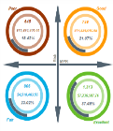
IBM Machine Learning for z/OS: Beta Client Use Case (Healthcare)
Goal:
Achieve the best possible outcomes by providing the most appropriate pharmacy and healthcare solutions
Solution
Apply machine learning's predictive capability to predict the STAR rating of patients in certain demographics and with certain phenotype
Based on the STAR rating,
Use differential rebates as financial vehicle
Provide value based benefits to the patients
Benefit
Patients: meet clinical goals, lower copay, “normal” life
Physician: use data to drive Pay for performance programs
Pharma: differential rebates. Align interests of health plan and pharma

Slide 49
Analytic Value with z14
32 TB Memory
z14
Analytic frameworks increasingly in-memory based, such as Machine Learning and Apache Spark
Scale-up capability key for efficient operation, high value is in integration with vast amounts of high value data and existing transactional systems
IBM z14 provides added memory capacity, and combined with z/OS functions in superior memory and cache management, analytic workloads derive advantage
IBM Open Data Analytics for z/OS also offers aggressive pricing for memory associated with this new analytic function
New analytic frameworks (such as Apache Spark) are based on Java, and with the increase in demand for scale-up, larger and larger Java heaps are required
As heaps grow, ‘collecting’ unused memory from objects no longer needed can cause delays in the processing of running Java applications -- -this kind of issue is seen across every platform and acknowledged to be a significant issue.
IBM z14 provides a guarded storage function to enable z/OS to more optimally detect usage of memory and significantly reduce pause-times of applications during the garbage collection process
The statistical and machine learning algorithms often used by analytic applications and popular ML libraries often involve complex mathematical operations
These instructions can have a performance impact on analytic operations, and since the actual operational code is sometimes generated, it may not be obvious which libraries are generating these instructions
IBM z14 provides an enhanced set of SIMD operations. These instructions have been incorporated into the instruction set used by the IBM Java and C/C++ runtimes so that analytic applications get the best performance possible for complex mathematical or vector related functions transparently.
Data drives and feeds analytic insights, differentiate business value by leveraging data-in-place strategies for analytics
Increased sensitivity due to data breaches and cybersecurity issues. As a result, data movement for analytics increases risk, or clients may choose not to expose all data for analysis to avoid factors.
With IBM z14 pervasive encryption, all data on disk can be encrypted, offering a significant security and governance advantage when combined with the data-in-place capabilities offered by IBM Open Data Analytics for z/OS.
Pause Less Garbage Collection
Enhanced SIMD Operations
Pervasive Encryption

Slide 50
Getting Started

Slide 51
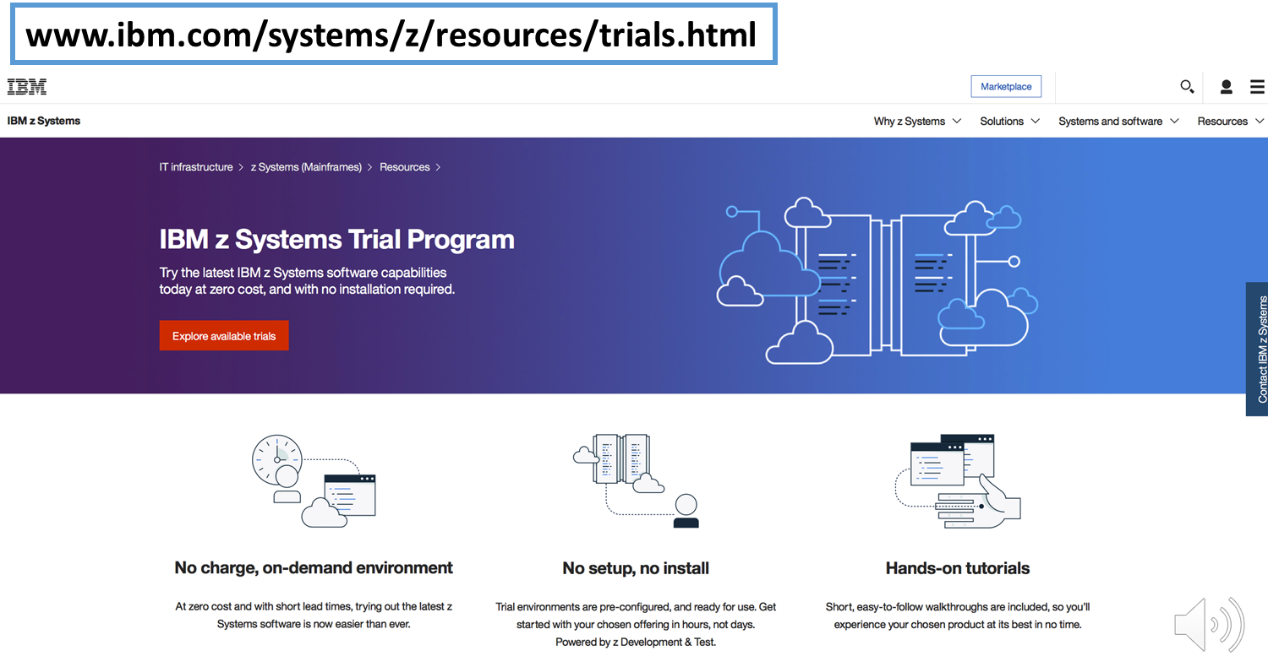
Try Apache Spark z/OS with no Installation Required

Slide 52
Useful Links
Machine Learning and z Systems:
https://www.youtube.com/watch?v=T2HtyNX7aHc
Machine Learning Launch Event interview:
https://www.youtube.com/watch?v=WHenFAa6iPw&feature=youtu.be&list=PLenh213llmca-QogcjfSW9RHPtNye9N_p
Gaining Agility with Spark Analytics on z Systems
https://www.youtube.com/watch?v=Y7HQbKBR_l4
Youtube of IBM Edge Analytics Segment featuring State of California and Jack Henry Associates
https://www.youtube.com/watch?v=ws9rLnXyb3g&feature=youtu.be (Analytics segment starts 26:25 into the video)
IBM z/OS Platform for Apache Spark
https://www-03.ibm.com/systems/z/os/zos/apache-spark.html
IBM Knowledge Center: z/OS Platform for Apache Spark
https://www.ibm.com/support/knowledgecenter/SSLTBW_2.2.0/com.ibm.zos.v2r2.azk/azk.htm
IBM Knowledge Center: IBM Machine Learning for z/OS
https://www.ibm.com/support/knowledgecenter/SS9PF4_1.1.0/src/tpc/mlz_home.html
Redbook: Apache Spark Implementation on IBM z/OS
http://www.redbooks.ibm.com/redbooks/pdfs/sg248325.pdf
IBM Machine Learning for z/OS Marketplace
https://www.ibm.com/us-en/marketplace/machine-learning-for-zos

Slide 53
Comments?

